Slide 1
IoT Protocol
Layer | Example
Infrastructure | 6LowPAN, IPv4/IPv6, RPL
Identification | EPC, uCode, IPv6, URIs
Comms / Transport | Wifi, Bluetooth, LPWAN
Discovery | Physical Web, mDNS, DNS-SD
Data Protocols | MQTT, CoAP, AMQP, Websocket, Node
Device Management | TR-069, OMA-DM
Semantic | JSON-LD, Web Thing Model
Multi-layer Frameworks | Alljoyn, IoTivity, Weave, Homekit

Slide 2
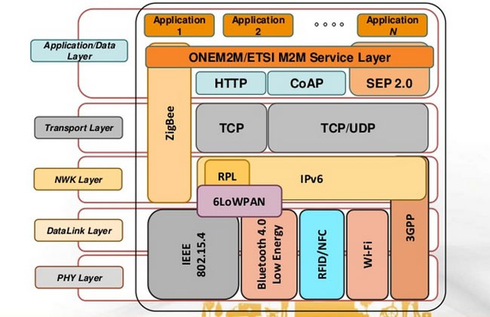
IoT Protocols - Overview
IoT Protocols
Low Power communication protocols : COAP, MQTT, RPL, 6LoWPAN, 802.15.4, Low Power Wide Area Network (3GPP and others)
Source: OneM2M
nter for Computer Technology and Applied M
July 31, 2017

Slide 3
IoT Protocols - Data Communication
Constrained Application Protocol (COAP)
⁾ RESTful protocol design minimizing the complexity of mapping with HTTP
⁾ Low header overhead and parsing complexity
⁾ URI and content-type support
⁾ Support for the discovery of resources provided by known CoAP services
⁾ Simple subscription for a resource, and resulting push notifications
Message Queuing Telemetry Transport (MQTT)
⁾ invented by IBM in 2000 for telemetry applications using low power data rates
⁾ enables a publish/subscribe messaging model in an extremely lightweight way
⁾ requires Small Code footprint and low bandwidth

Slide 4
IoT Protocols - Local Network Communication
IEEE 802.15.4
IEEE 802.15.4 is a standard which specifies the physical layer and media access control for low-rate wireless personal area networks (LR-WPANs).
It is maintained by the IEEE 802.15 working group
It is the basis for the ZigBee,ISA100.11a, WirelessHART, and MiWi specifications, each of which further extends the standard by developing the upper layers which are not defined in IEEE 802.15.4
It is used with 6LoWPAN and standard Internet protocols to build a wireless embedded Internet.
Zigbee
⁾ Uses the 802.15.4 standard and operates in the 2.4 GHz frequency range with 250 kbps
⁾ The maximum number of nodes in the network is 1024 with a range up to 200 meter. ZigBee can use 128 bit AES encryption.

Slide 5
IoT Protocols - Local Network Communication
IoT Protocols
Bluetooth Low Energy
⁾ designed and marketed by the Bluetooth Special Interest Group
⁾ Different Profiles for Different applications
⁾ Provide the same range as classic bluetooth with considerable low energy consumption
⁾ the technology used in beacons used to send contextual information
based on locations (Google beacon platform , Google Physical web, Apple ibeacon)
nter for Computer Technology and Applied M
July 31, 2017

Slide 6
IoT Protocols - Low Power Wide Area Network (LPWAN)
IoT Protocols
Weightless is a proposed proprietary open wireless technology standard for exchanging data between a base station and thousands of machines around it (using wavelength radio transmissions in unoccupied TV transmission channels) with high levels of security.
NB-IoT (Narrow-Band IoT) A technology being standardized by the 3GPP standards body
LTE-MTC (LTE-Machine Type Communication) -
Standards-based family of technologies supports several technology categories, such as Cat-1 and CatM1, suitable for the IoT.
EC-GSM-IoT (Extended Coverage-GSM-IoT) - Enables new capabilities of existing cellular networks for LPWA (Low Power Wide Area) IoT applications. EC-GSM-IoT can be activated through new software deployed over a very large GSM footprint, adding even more coverage to serve IoT devices.
nter for Computer Technology and Applied M
July 31, 2017

Slide 7
IoT Protocols - Low Power Wide Area Network (LPWAN)
IoT Protocols
Sigfox is a French company that build Low Power wide network for connected devices using its proprietary protocol.
LoRaWAN - Network protocol intended for wireless battery operated Things in regional, national or global network. It is managed by Lora Alliance.
RPMA (Random phase multiple access) A technology communication system employing direct-sequence spread spectrum (DSSS) with multiple access.
nter for Computer Technology and Applied M
July 31, 2017

Slide 8
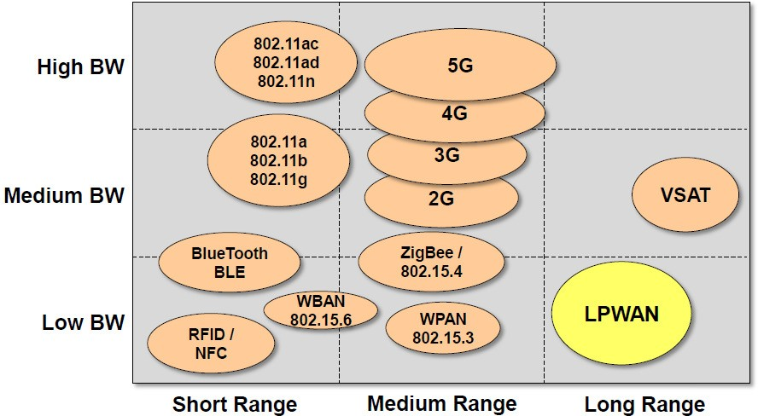
IoT Protocols
IoT Protocols - Low Power Wide Area Network (LPWAN)
Source: indigoo.com
nter for Computer Technology and Applied M
July 31, 2017

Slide 9
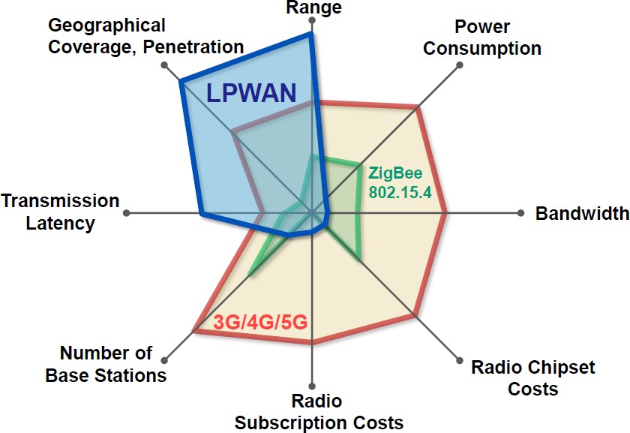
IoT Protocols
IoT Protocols - Low Power Wide Area Network (LPWAN)
Source: indigoo.com
nter for Computer Technology and Applied M
July 31, 2017

Slide 10
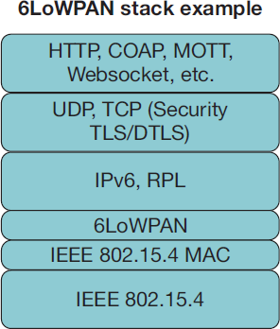
IoT Protocols - Routing Protocols
IoT Protocols
IPv6 over Low power Wireless Personal Area Networks (6LoWPAN)
⁾ An adaption layer for IPv6 over IEEE802.15.4 links
⁾ Operates only in the 2.4 GHz frequency range with 250 kbps transfer rate
Routing Protocol for low Power and Lossy Networks (RPL)
⁾ Developed by IETF ROLL Working Group
⁾ Ideal for N to 1 links (meters reading)
nter for Computer Technology and Applied M
July 31, 2017

Slide 11
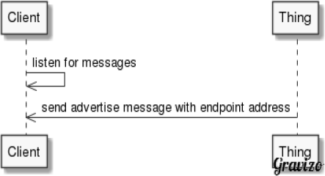
IoT Protocols - Discovery
IoT Protocols
Search around me: This category of discovery includes technologies that allow to discover things around me (in a spatial sense)
⁾ NFC
⁾ UriBeacon (Formerly known as Physical Web from Google)
⁾ iBeacon (from Apple)
nter for Computer Technology and Applied M
July 31, 2017

Slide 12
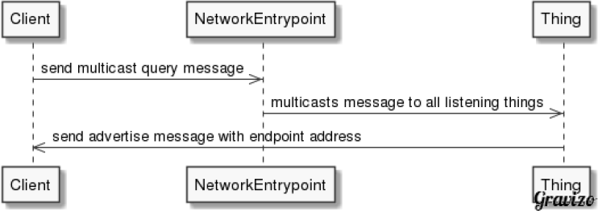
IoT Protocols - Discovery
IoT Protocols
Search on my network: It covers technologies enabling discovery of things on the network.
⁾ mDNS
⁾ SSDP
nter for Computer Technology and Applied M
July 31, 2017

Slide 13
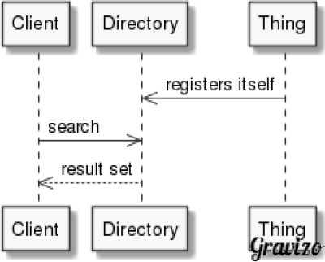
IoT Protocols - Discovery
IoT Protocols
Searching in a directory:
⁾ A central directory is used for discovery of things and resources
⁾ Discovery requests are sent to the directory
CoRE Resource Directory
XMPP IoT Discovery SPARQL Endpoints
nter for Computer Technology and Applied M
July 31, 2017

Slide 14
IoT Protocols - Discovery
IoT Protocols
Search Across Peers:
⁾ In P2P style discovery, the directory is essentially distributed across the peers
⁾ Distributed hash tables (DHT) is often used to map the search space into a numeric range and then allocates servers to parts of that range
⁾ Observation: the technique works well for scale free networks
nter for Computer Technology and Applied M
July 31, 2017

Slide 15
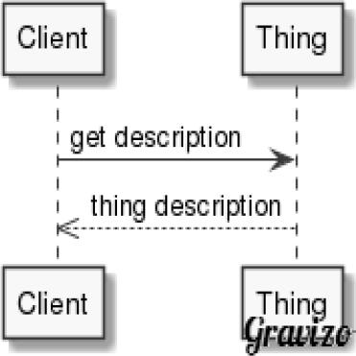
IoT Protocols - Discovery
IoT Protocols
Search for Thing Metadata:
⁾ Once a thing” has been discovered with mentioned mechanisms
next ”resources” (thing metadata) access at thing level needs to be performed
⁾ Examples
CoAP + CoRE Link Format (for thing metadata)
Sensor Observation Service (SOS): it is a web service which allows querying sensor metadata.
nter for Computer Technology and Applied M
July 31, 2017

Slide 16
CoAP(Constrained Application Protocol)
"CoAP is an application layer protocol that is intended for use in resource-constrained internet devices, such as WSN nodes.
CoAP is designed to easily translate to HTTP for simplified integration with the web, while also meeting specialized requirements such as multicast support, very low overhead, and simplicity. The CoRE group has proposed the following features for CoAP: RESTful protocol design minimizing the complexity of mapping with HTTP, Low header overhead and parsing complexity, URI and content-type support, Support for the discovery of resources provided by known CoAP services. Simple subscription for a resource, and resulting push notifications, Simple caching based on max-age."

